Slide 1
Xcode 4: Deploying Your App to Your Own iPhone
Requirements:
iPhone/iPad
Mac with OSX
Apple Developer Program
$99 per year - developer.apple.com
Or educational program

Slide 2
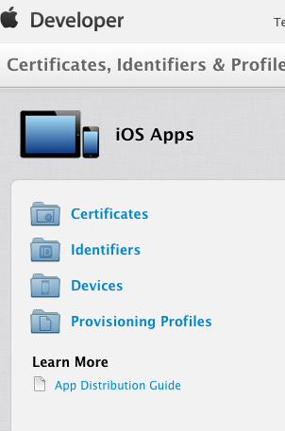
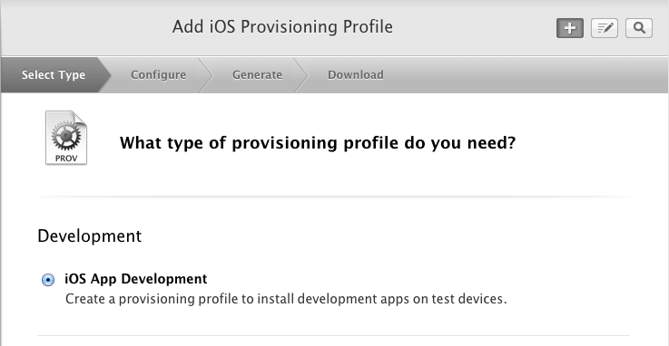
Certificates, Identifiers & Profiles
Login your account at developer.apple.com
Certificate - let apple knows who you are
Identifier - create and register App ID
Device - register your iOS device
Provisioning Profile - Create a provisioning profile to install development apps on test devices.

Slide 3
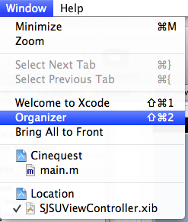
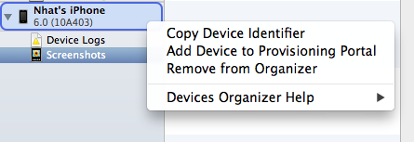
Xcode 4
Open Xcode->Window->Organizer
Right-click on your iPhone device
and click on "Add device to Provisioning Portal
3. Prompt to login your apple developer account. Just follow the instructions given by Apple.

Slide 4
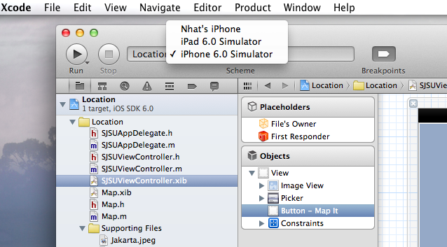
Deploy your app to iPhone
1. Change the build location from Simulator to iPhone
2. Click "Run" to deploy your app to iPhone

